Slide 1
Computer Graphics
Color Theory

Slide 2
Topics
Colors
CIE Color Model
RGB Color Model
CMY Color Model
YIQ Color Model
Intuitive Color Concepts
HSV Color Model
HLS Color Model

Slide 3
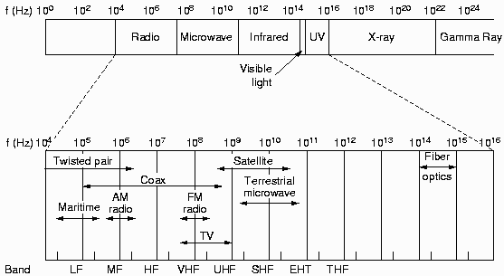
Colors
Colors
  A narrow frequency band within the electromagnetic spectrum

Slide 4
Colors
Visible band
  Each frequency corresponds to a distinct color
  Low-frequency end (4.3 x 10¹⁴ Hz): Red
  High-frequency end (7.5 x 10¹⁴ Hz): Violet
  Wavelength λ = v/f, where v=300,000km/sec
  Low frequency High frequency
  red orange yellow green blue violet
  Long wavelength Short wavelength
  700nm 400nm

Slide 5
Colors
Colors of an object
  Light source emits “white light” (all frequencies of light)
  Object reflects/absorbs some frequencies
  Color = combination of frequencies reflected
Dominant wavelength (or frequency)
  Hue or color of the light
  E.g., pink
S(λ): spectrum (luminance/intensity of light)
λ
400
620
700

Slide 6
CIE Color Model
Color models
  Use three primary colors to produce other colors
Primary colors
  Colors used in a color model to produce all the other colors in that model.
  Cannot be made from the other (two) colors defining the model.
CIE color model
  X, Y, and Z: nonexistent, super saturated colors
    Vectors in 3-D additive color space
  Any color S = AX + BY + CZ

Slide 7
CIE Color Model
S = AX + BY + CZ can be normalized to
  x = A/(A+B+C)
  y = B/(A+B+C)
  z = C/(A+B+C)
  ➔ s = xX + yY + zZ, where x + y + z = 1
  ➔ s lies in the plane x + y + z = 1 in 3D
y
λ=670
x
λ=400
z

Slide 8
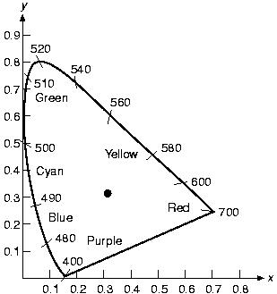
CIE Color Model
CIE chromaticity diagram
  s'(λ) = (x(λ), y(λ))
  By viewing the 3D
  curve in an
  orthographic
  projection, looking
  along the z-axis
  horseshoe shape
y
λ=670
x
λ=400
z

Slide 9
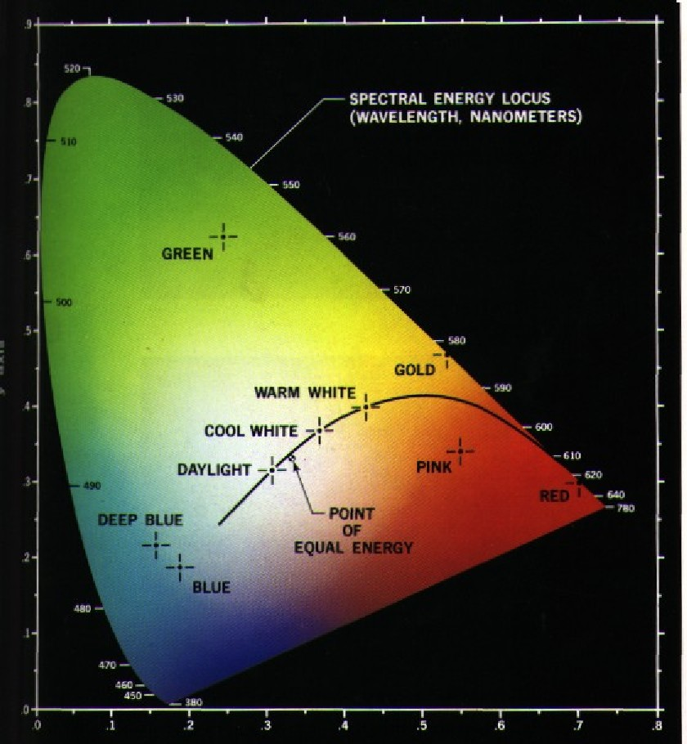
CIE Chromaticity Diagram

Slide 10
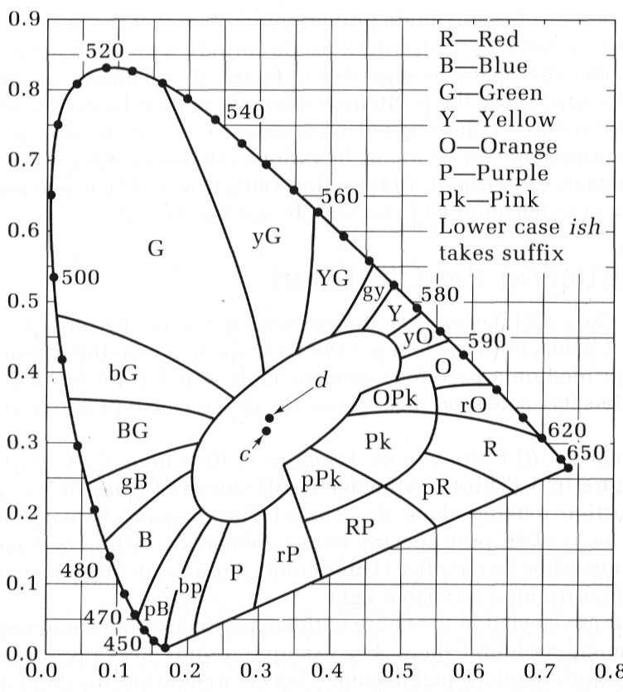
CIE Chromaticity Diagram

Slide 11
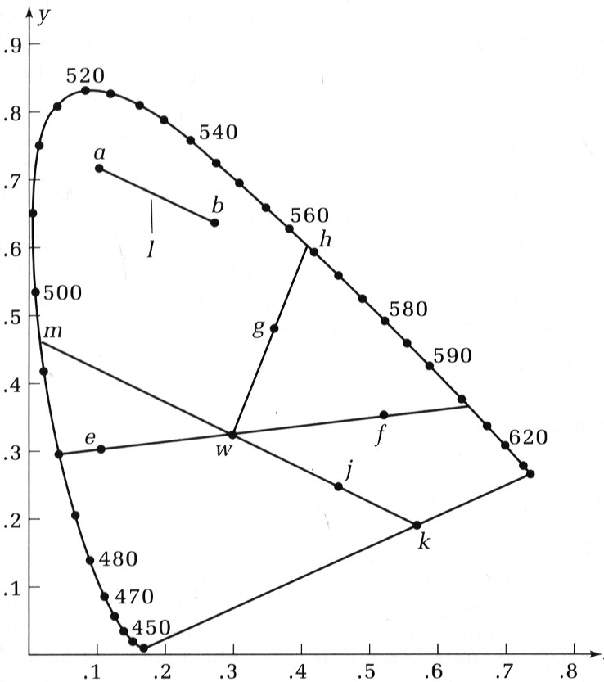
Uses of CIE Chromaticity Diagram

Slide 12
Uses of CIE Chromaticity Diagram
Any colors on the line l between two colors a and b
  Is a convex combination of a and b
  Is a legitimate color
  can be generated by shining various amounts of a and b onto a screen (like “tweening”)
Complementary colors
  Any two colors on a line passing through white and added up to be white are complementary e.g., e and f
  red⇔cyan green⇔magenta blue⇔yellow

Slide 13
Uses of CIE Chromaticity Diagram
Measure dominant wavelength and saturation
  Color g: Some combination of h and white
  Dominant wavelength of g = wavelength at h
  Saturation (purity) of g = (g - w) / (h - w)
Color j has no dominant wavelength because k is not a pure color (k lies on the purple line)
  Represented by dominant wavelength of k’s complement m, with by a c suffix, e.g., 498_{c}

Slide 14
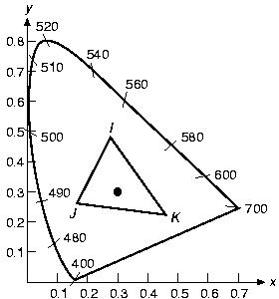
Uses of CIE Chromaticity Diagram
Any color within a triangle can be generated by the three vertices of the triangle
  Any point inside
  ΔIJK is a convex
  combination of
  points I, J, and K

Slide 15
Uses of CIE Chromaticity Diagram
Define color gamuts
  Range of colors that can be produced on a device
CRT monitor’s gamut is different from printer’s (See Plate 33 in the textbook)
Any choice of three primaries can never encompass all visible colors
RGB are natural choices for primaries as they can cover the largest part of the “horseshoe”

Slide 16
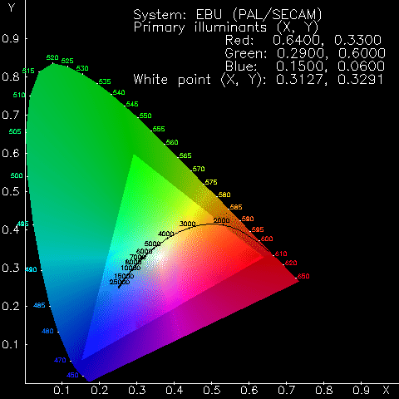
Gamut Example

Slide 17
RGB Color Model
Used in light emitting devices
  Color CRT monitors
Additive
  Result = individual contributions of each primary color added together
  C = rR + gG + bB, where r, g, b ∈ [0, 1]
  R = (1, 0, 0)
  G = (0, 1, 0)
  B = (0, 0, 1)

Slide 18
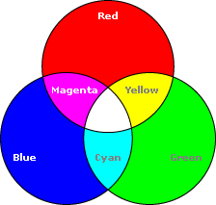
RGB Color Model

Slide 19
RGB Color Model
Color Cube
  R + G = (1, 0, 0) + (0, 1, 0) = (1, 1, 0) = Y
  R + B = (1, 0, 0) + (0, 0, 1) = (1, 0, 1) = M
  B + G = (0, 0, 1) + (0, 1, 0) = (0, 1, 1) = C
  R + G + B = (1, 1, 1) = W
  1 – W = (0, 0, 0) = BLK
  Grays = (x, x, x), where x ∈ (0, 1)

Slide 20
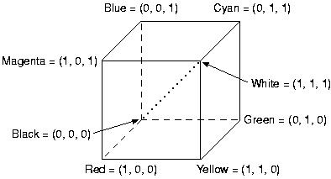
Color Cube

Slide 21
CMY Color Model
CMY: Complements of RGB
Used in light absorbing devices
  Hardcopy output devices
Subtractive
  Color specified by what is subtracted from white light
  Cyan absorbs red, magenta absorbs green, and yellow absorbs blue

Slide 22
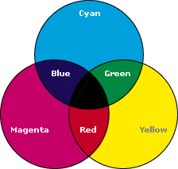
CMY Color Model

Slide 23
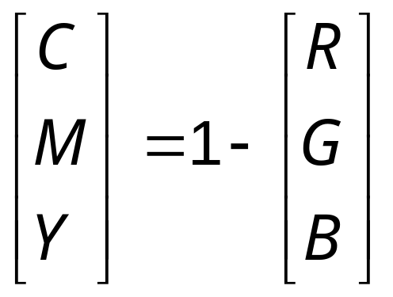
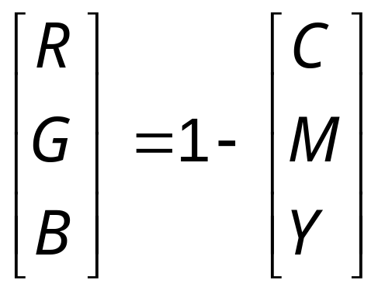
CMY Color Model
W = (0, 0, 0) B = (1, 1, 1)
Conversion from RGB to CMY
Conversion from CMY to RGB

Slide 24
CMYK Color Model
Motivations
  Do we get black if paint cyan, magenta and yellow on a white paper?
  Which cartridge is more expensive?
CMYK model
  K = greatest gray that can be extracted
Given C, M, and Y
  K = min(C, M, Y)
  C = C – K
  M = M – K
  Y = Y – K
Try some examples…

Slide 25
YIQ Color Model
Used in U.S. commercial color-TV broadcasting
  Recoding of RGB for transmission efficiency
  Backward compatible with black-and-white TV
  Transmitted using NTSC (National Television System Committee) standard

Slide 26
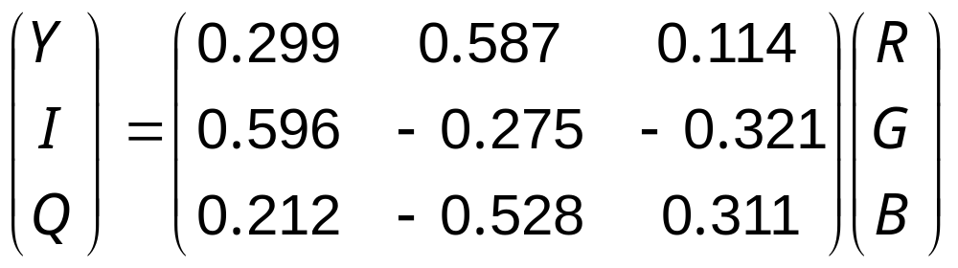
YIQ Color Model
YIQ
  Y: luminance
  I, Q: chromaticity
  Only Y shown in black-and-white TV
RGB → YIQ

Slide 27
YIQ Color Model
Human’s visual properties
  More sensitive to changes in luminance than in hue or saturation
  ➔ more bits should be used to represent Y than I and Q
  Limited color sensation to objects covering extremely small part of our field of view
  ➔ One, rather than two color dimensions would be adequate
  ➔ I or Q can have a lower bandwidth than the others

Slide 28
YIQ Color Model
NTSC encoding of YIQ into broadcast signal
  Uses human’s visual system properties to maximize information transmitted in a fixed bandwidth
  Y: 4MHz
  I: 1.5MHz
  Q: 0.6MHz

Slide 29
Intuitive Color Concepts
Terminology
Perceptual Term | Colorimetry | Comments
hue | dominated wavelength | to distinguish colors
saturation | excitation purity | e.g., red and pink
Lightness (reflecting objects) | luminance
Brightness (self-luminous objects) | luminance | e.g., Sun, CRT

Slide 30
Intuitive Color Concepts
tints
white
pure color
tones
  Tint: white pigment added to pure pigment
  ➔ saturation reduced
  Shade: black pigment added to pure pigment
  ➔ lightness reduced
  Tone: consequence of adding both white and black pigments to pure pigments
grays
shades
black

Slide 31
Intuitive Color Concepts
Tints, shades, and tones ➔ different colors of same hue are produced
Grays
= black pigments + white pigments
Graphics packages that provide color palettes to users often employ two or more color models

Slide 32
HSV Color Model
HSV = Hue, Saturation, and Value
  A.k.a. HSB, where B is Brightness
RGB, CMY, and YIQ: hardware-oriented
HSV and HLS: user-oriented
Cylinder coordinate system
  Space: hexcone
  hexagon is obtained from the color cube in isometric projection
  (h, s, v), where h ∈ [0, 360) and s, v ∈ [0, 1]
    hue: angle round the hexagon
    saturation: distance from the center
    value: axis through the center

Slide 33
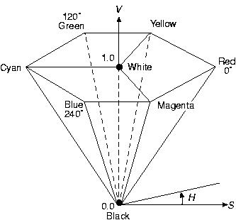
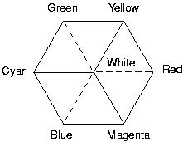
HSV Color Model
Color Cube Hexcone

Slide 34
HSV Color Model
W = (-, 0, 1)
B = (-, 0, 0)
R = (0, 1, 1)
Y = (60, 1, 1)
:
M = (300, 1, 1)
Adding white pigments ⇔ S↓
Adding black pigments ⇔ V↓
Creating tones ⇔ S↓ and V↓

Slide 35
HSV Color Model
True color system: 16 million colors
Q: Do we need that many?
Human eyes can distinguish
  128 hues
  130 tints (saturation levels)
  23 shades of yellow colors, 16 of blue colors
  ➔ 128 x 130 x 23 = 82720 colors

Slide 36
HLS Color Model
HLS: Hue, Lightness, and Saturation
Cylinder coordinate system
  Space: double cone
  base is from the hexagon as in HSV
  (h, l, s), where h ∈ [0, 360) and s, v ∈ [0, 1]
    hue: angle round the base
    lightness: axis through the center
    saturation: distance from the center
W = (-, 0, 1)
B = (-, 0, 0)
R = (0, 0.5, 1), Y = (60, 0.5, 1), …

Slide 37
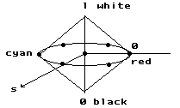
HLS Color Model
Double cones
white
pure
color
h
black

